Slide 1

Security
Rasmus Lystrøm
Associate Professor
ITU

Slide 2

Agenda
Authentication and Authorization
Azure Active Directory
ASP.NET Core Web API and Blazor
Encryption in Transit
Secrets
SQL Security
Container Security
Penultimate lecture
This Photo by Unknown Author is licensed under CC BY-NC-ND

Slide 3
Security

Slide 4

Authentication vs. Authorization

Slide 5
Authentication Options
(None)
(Individual User Accounts)
Azure Active Directory
(Windows)

Slide 6
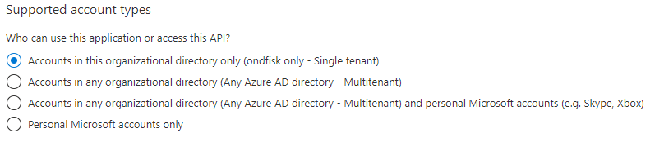
Azure Active Directory (AzureAD/AAD)
Azure Active Directory (Azure AD) is Microsoft’s cloud-based identity and access management service, which helps your employees sign in and access resources in:
External resources, such as Microsoft 365, the Azure portal, and thousands of other SaaS applications.
Internal resources, such as apps on your corporate network and intranet, along with any cloud apps developed by your own organization.

Slide 7
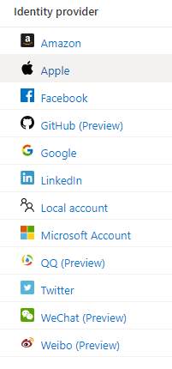
Azure AD B2C
Business to Consumer

Slide 8
Key takeaway: Don’t roll your own security/identity layer

Slide 9

Image source: http://lazergaze.tumblr.com/post/26333564955

Slide 10
Security in ASP.NET Core Web API
Demo
https://docs.microsoft.com/en-us/aspnet/core/blazor/security/webassembly/hosted-with-azure-active-directory

Slide 11

Encryption in Transit

Slide 12

Encryption in Transit
SSL
HTTPS
TLS 1.2

Slide 13
Encryption in Transit
Always enforce HTTPS
Do not expose HTTP – except for automatic redirect – TEST
Containers should communicate over secure channels only (cf. Dapr and Azure Container Apps)

Slide 14

Secrets

Slide 15
Secrets
Use user-secrets in DEV
Use platform specific secret handling in PROD:
Azure Key Vault
App Services settings
HashiCorp Vault

Slide 16

SQL Security

Slide 17

SQL Security
Azure Managed Identity
Don’t use SA in production
Discrete user per app

Slide 18

Container Security

Slide 19
Container Security
All applies!
No exceptions
Containers are not a security layer
Network security does not count!
Assume compromise!
HTTPS: https://docs.microsoft.com/en-us/aspnet/core/security/docker-https

Slide 20
Security
Demo

Slide 21

Penultimate Lecture

Slide 22
Last Lecture
December 3 will be the last one
What are we missing?
What do you want repeated?
Will cover:
Continuous deployment of MyApp to Azure using GitHub Actions

Slide 23
Thank You

